Slide 1
By patel meet sql project
PRSQL02 Medical data history

Slide 2



1. Show first name, last name, and gender of patients whose gender is 'M'
2. Show first name and last name of patients who does not have allergies.
-- Q2: select first_name,last_name from patients where allergies is null;
-- Q1: select first_name, last_name, gender from patients where gender='M';

Slide 3


3. Show first name of patients that start with the letter 'C'
4. Show first name and last name of patients that weight within the range of 100 to 120 (inclusive)
-- Q3: select first_name from patients where first_name like 'c%';
-- Q4: select first_name, last_name from patients where weight between 100 and 120;

Slide 4
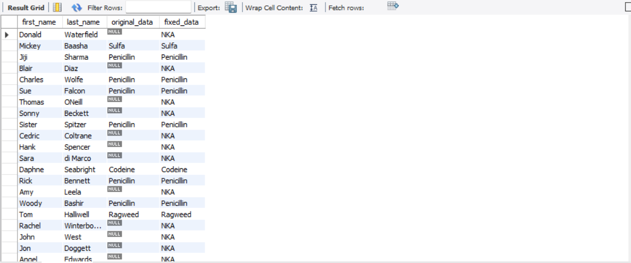

5. Update the patients table for the allergies column. If the patient's allergies is null then replace it with 'NKA'
6. Show first name and last name concatenated into one column to show their full name.
-- Q5: select first_name,last_name,allergies as original_data,coalesce(allergies, 'NKA') as fixed_datafrom patients;
-- Q6: select concat(first_name,' ',last_name) as full_name from patients;select concat(first_name,' ',last_name) as full_name from doctors;

Slide 5

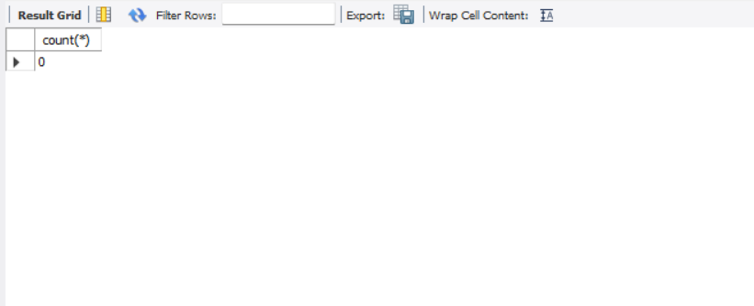
7. Show first name, last name, and the full province name of each patient.
8. Show how many patients have a birth_date with 2010 as the birth year.
-- Q7: SELECT p.first_name, p.last_name,pr.province_name FROM patients pJOIN province_names pr ON p.province_id = pr.province_id;
-- Q8: select count(*) from patients where birth_date like '%2010';

Slide 6

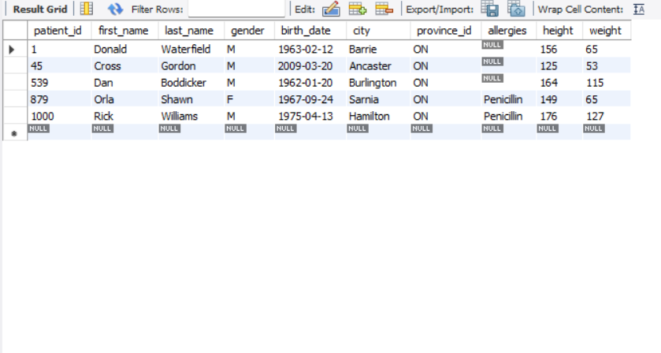
9. Show the first name, last name, and height of the patient with the greatest height.
10. Show all columns for patients who have one of the following patient_ids: 1,45,534,879,1000
-- Q9: select first_name,last_name,height from patients where height = (select max(height)from patients);
-- Q10: select * from patients where patient_id in (1,45,539,879,1000);

Slide 7

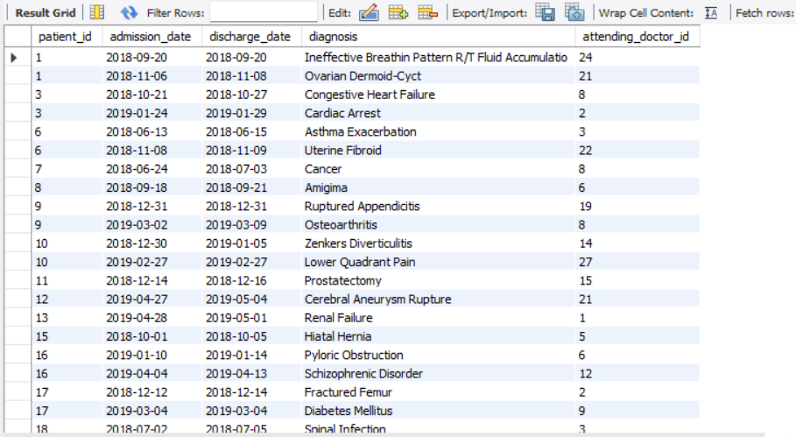
11. Show the total number of admissions
12. Show all the columns from admissions where the patient was admitted and discharged on the same day.
-- Q11: select count(*) from admissions;select * from admissions;
-- Q12: select * from admissionswhere admission_date = discharge_date;

Slide 8

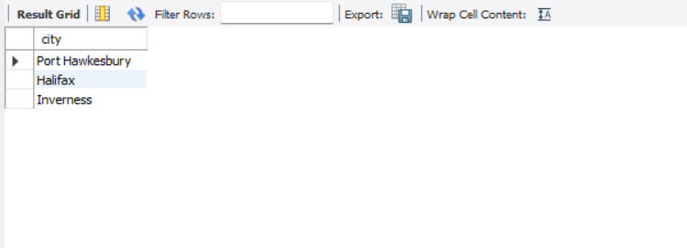
13. Show the total number of admissions for patient_id 579.
14. Based on the cities that our patients live in, show unique cities that are in province_id 'NS'?
-- Q13: select count(*) from admissions where patient_id = '579';
-- Q14: select distinct city from patients where province_id = 'NS';

Slide 9
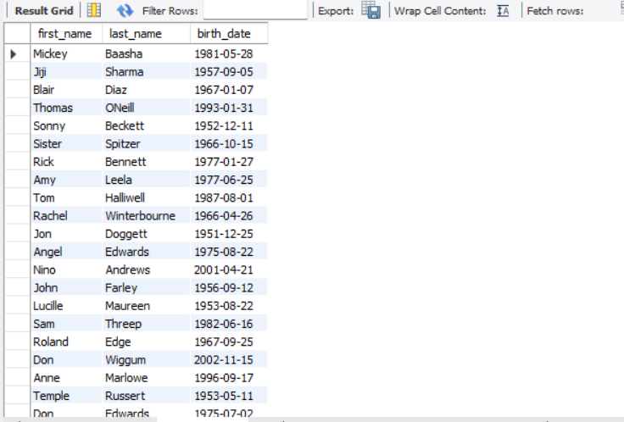

15. Write a query to find the first_name, last name and birth date of patients who have height more than 160 and weight more than 70
16. Show unique birth years from patients and order them by ascending.
-- Q15: select first_name,last_name,birth_date from patients where height > 160 and weight > 70;
-- Q16: select distinct year(birth_date) from patients order by year(birth_date) ASC;

Slide 10

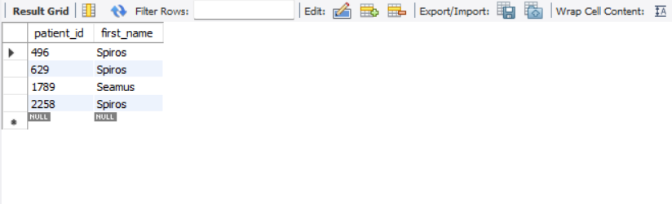
17. Show unique first names from the patients table which only occurs once in the list.
18. Show patient_id and first_name from patients where their first_name start and ends with 's' and is at least 6 characters long.
-- Q17: select first_name from patients group by first_name having count(first_name) = 1;
-- Q18: select patient_id,first_name from patients where first_name like 's%s' and length(first_name)= 6;

Slide 11
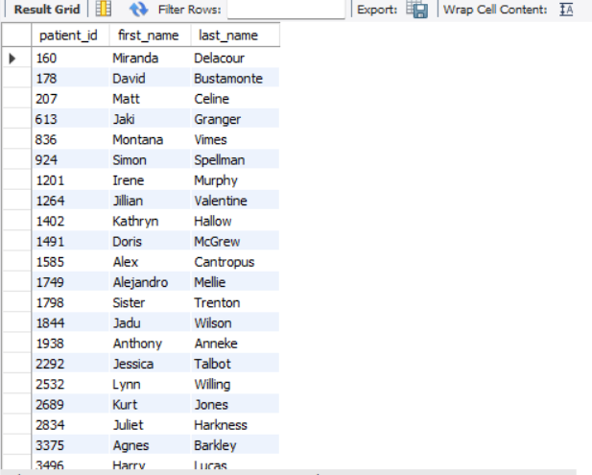

19. Show patient_id, first_name, last_name from patients whos diagnosis is 'Dementia'. Primary diagnosis is stored in the admissions table.
20. Display every patient's first_name. Order the list by the length of each name and then by alphbetically.
-- Q19: select p.patient_id,p.first_name,p.last_name from patients p join admissions a on p.patient_id = a.patient_id where a.diagnosis = 'dementia';
-- Q20: select first_name from patients order by length(first_name),first_name;

Slide 12

21. Show the total amount of male patients and the total amount of female patients in the patients table. Display the two results in the same row.
22. Show the total amount of male patients and the total amount of female patients in the patients table. Display the two results in the same row.
-- Q21: SELECT SUM(CASE WHEN gender = 'M' THEN 1 ELSE 0 END) AS male_count, SUM(CASE WHEN gender = 'F' THEN 1 ELSE 0 END) AS female_count FROM patients;
-- Q22: SELECT SUM(CASE WHEN gender = 'M' THEN 1 ELSE 0 END) AS male_count, SUM(CASE WHEN gender = 'F' THEN 1 ELSE 0 END) AS female_count FROM patients;

Slide 13
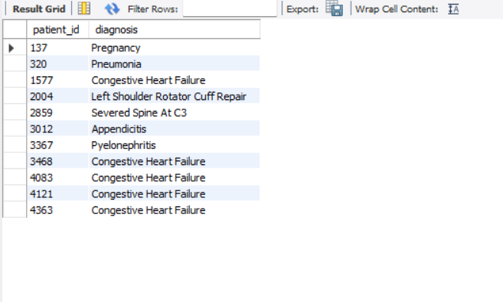

23. Show patient_id, diagnosis from admissions. Find patients admitted multiple times for the same diagnosis.;
24. Show the city and the total number of patients in the city. Order from most to least patients and then by city name ascending.
.
-- Q23: SELECT patient_id,diagnosis FROM admissions GROUP BY patient_id,diagnosis HAVING COUNT(*) > 1;
-- Q24: select city,count(*) As patient_countfrom patients group by cityorder by patient_count desc,city asc;

Slide 14
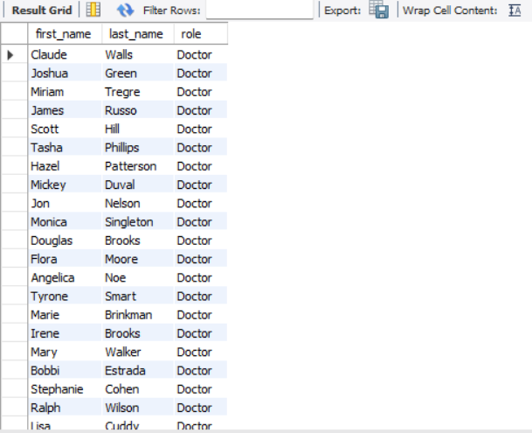
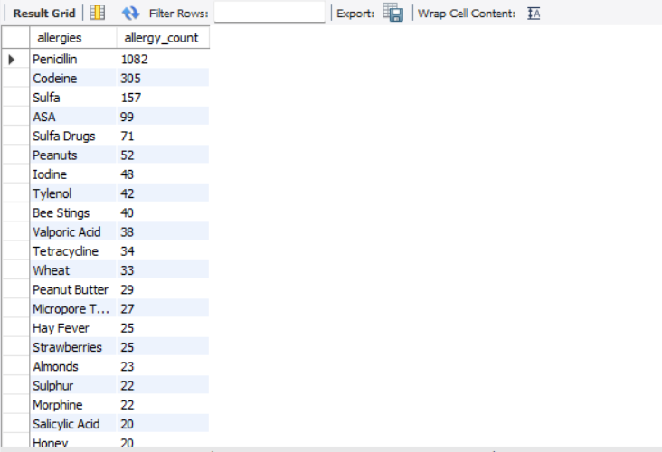
25. Show first name, last name and role of every person that is either patient or doctor. The roles are either "Patient" or "Doctor"
26. Show all allergies ordered by popularity. Remove NULL values from query.
-- Q25: SELECT first_name, last_name, 'Doctor' AS roleFROM doctorsUNION ALLSELECT first_name, last_name, 'Patient' AS role FROM patients;
-- Q26: SELECT allergies,COUNT(*) AS allergy_count FROM patients WHERE allergies IS NOT NULLGROUP BY allergies ORDER BY allergy_count DESC;

Slide 15
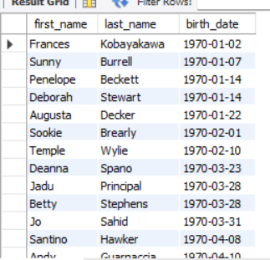
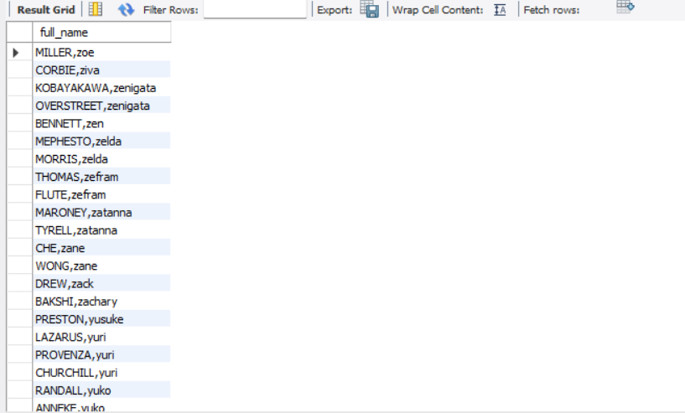
27. Show all patient's first_name, last_name, and birth_date who were born in the 1970s decade. Sort the list starting from the earliest birth_date.
28. We want to display each patient's full name in a single column. Their last_name in all upper letters must appear first, then first_name in all lower case letters. Separate the last_name and first_name with a comma. Order the list by the first_name in decending order
-- Q27: SELECT first_name,last_name, birth_date FROM patients WHERE birth_date BETWEEN '1970-01-01’ AND '1979-12-31'ORDER BY birth_date ASC;
-- Q28: select concat (upper(last_name),',', lower(first_name))as full_name from patients order by first_name desc;

Slide 16


29. Show the province_id(s), sum of height; where the total sum of its patient's height is greater than or equal to 7,000.
30. Show the difference between the largest weight and smallest weight for patients with the last name 'Maroni'
-- Q29: select province_id, sum(height) astotal_height from patients group by province_id having total_height>= 7000;
-- Q30: select (max(weight) - min(weight)) as weight_difference from patients where last_name = 'Maroni';

Slide 17

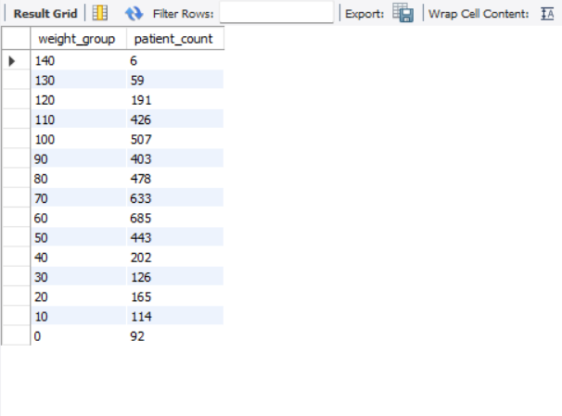
31. Show all of the days of the month (1-31) and how many admission_dates occurred on that day. Sort by the day with most admissions to least admissions.
32. Show the total amount of patients in each weight group. Order the list by the weight group decending. e.g. if they weight 100 to 109 they are placed in the 100 weight group, 110-119 = 110 weight group,
-- Q31: select day(admission_date) as day_number,count(*) as number_of_admissions from admissions group by day_number order bynumber_of_admissions desc;
-- Q32: SELECT (FLOOR(weight / 10) * 10) AS weight_group,COUNT(*) AS patient_countFROM patientsGROUP BY weight_groupORDER BY weight_group DESC;

Slide 18
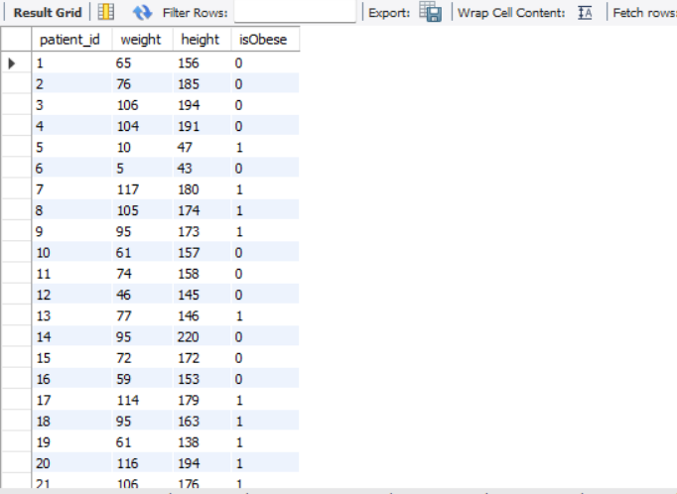
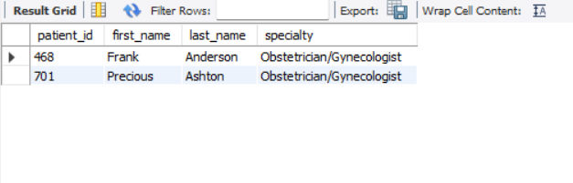
33. Show patient_id, weight, height, isObese from the patients table. Display isObese as a boolean 0 or 1. Obese is defined as weight(kg)/(height(m). Weight is in units kg. Height is in units cm.
34. Show patient_id, first_name, last_name, and attending doctor's specialty. Show only the patients who has a diagnosis as 'Epilepsy' and the doctor's first name is 'Lisa'. Check patients, admissions, and doctors tables
-- Q33: SELECT patient_id,weight,height, CASE WHEN weight / POWER(height / 100.0, 2) >= 30 THEN 1 ELSE 0 END AS isObese FROM patients;
-- Q34: SELECT p.patient_id,p.first_name, p.last_name,d.specialty FROM patients pJOIN admissions a ON p.patient_id,a.patient_id JOIN doctors d ON a.attending_doctor_id = d.doctor_id WHERE a.diagnosis = 'Epilepsy'AND d.first_name = 'Lisa';

